Slide 1
Randomized Algorithms CS648
Lecture 12
Hashing – I

Slide 2

Problem Definition
$U=\left\{1,2,…,m\right\}$ called universe
$S⊆U$ and $s=|S|$
$s≪$ $m$
Examples:
$m={10}^{18}$ , $s={10}^{3}$
Aim
Build a data structure for a given $S$to support the search query :
“Does $i∈$ $S$ ?” for any $i∈U$.

Slide 3


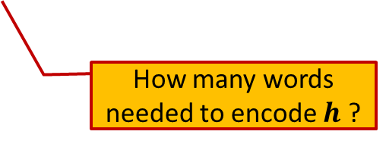
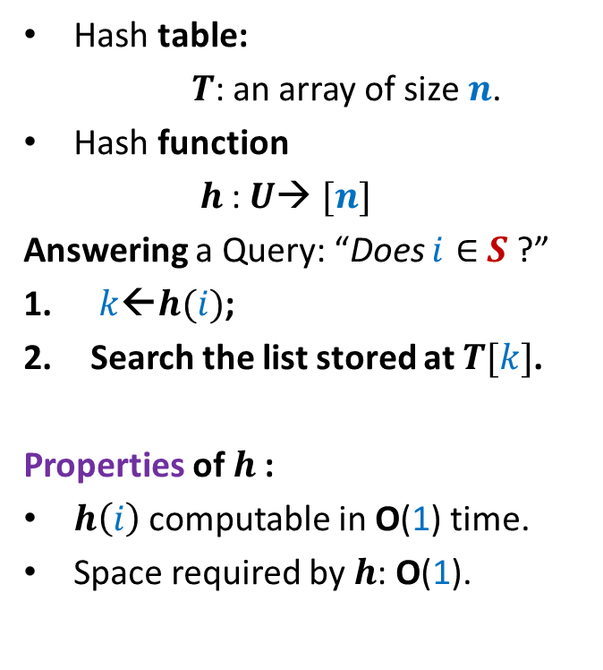

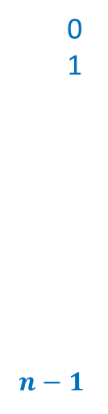

Hashing
Hash table:
$T$: an array of size $n$.
Hash function
$h$: $U$→ $[n]$
Answering a Query: “Does $i∈$ $S$ ?”
$k$←$h(i)$;
Search the list stored at $T[k]$.
Properties of $h$:
$h\left(i\right)$ computable in O(1) time.
Space required by $h$: O(1).
Elements of $S$
$$T$$
0
1
$$n−1$$
$$⋮$$
$$⋮$$
How many words needed to encode $h$ ?

Slide 4
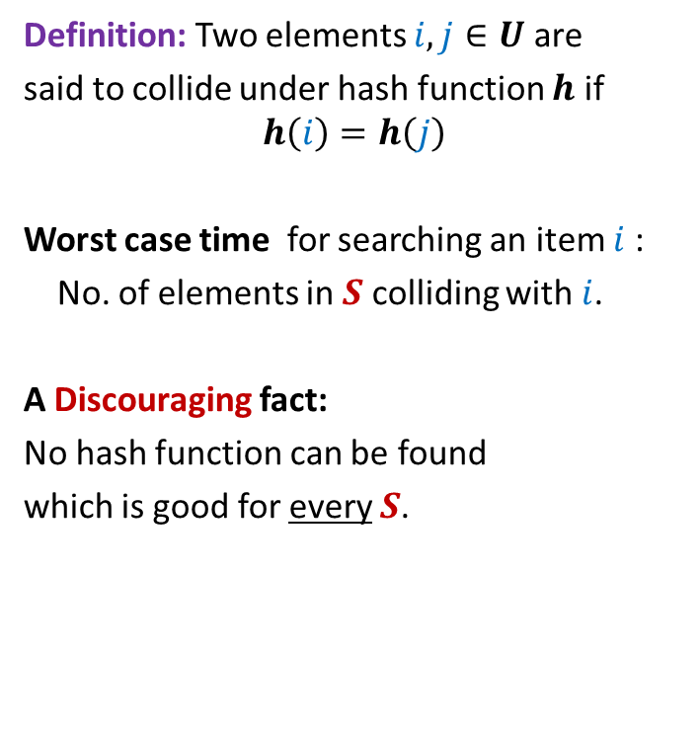
Collision
Definition: Two elements $i,j∈U$ are
said to collide under hash function $h$ if
$$h\left(i\right)=h\left(j\right)$$
Worst case time for searching an item $i$:
No. of elements in $S$ colliding with $i$.
A Discouraging fact:
No hash function can be found
which is good for every $S$.
$$T$$
0
1
$$n−1$$
$$⋮$$
$$⋮$$

Slide 5



Key idea to achieve worst case O(1) search time
No hash function which is good for every $S$
A good hash function for a given $S$

Slide 6
Why does hashing work so well in Practice ?

Slide 7
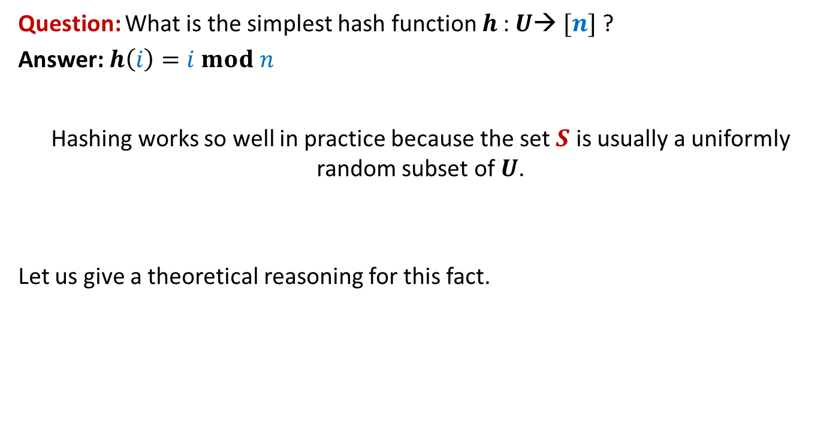
Why does hashing work so well in Practice ?
Question: What is the simplest hash function $h$: $U$→ $[n]$ ?
Answer: $h\left(i\right)=i mod n$
Hashing works so well in practice because the set $S$ is usually a uniformly random subset of $U$.
Let us give a theoretical reasoning for this fact.

Slide 8











Why does hashing work so well in Practice ?
Let $y_{1},y_{2},…,y_{s}$ denote $s$elements
selected randomly uniformly from $U$ to form $S$.
Question:
What is expected number of elements
colliding with $y_{1}$?
Answer: Let $y_{1}$ takes value $i$.
P($y_{j}$ collides with $y_{1}$) = ??
1
2
$$⋮$$
$$i−n$$
$$i$$
How many possible values can $y_{j}$ take ?
$$i+n$$
$$m−1$$
$$i+2n$$
How many possible values can collide with $i$ ?
$$i+3n$$
$$⋮$$
m

Slide 9
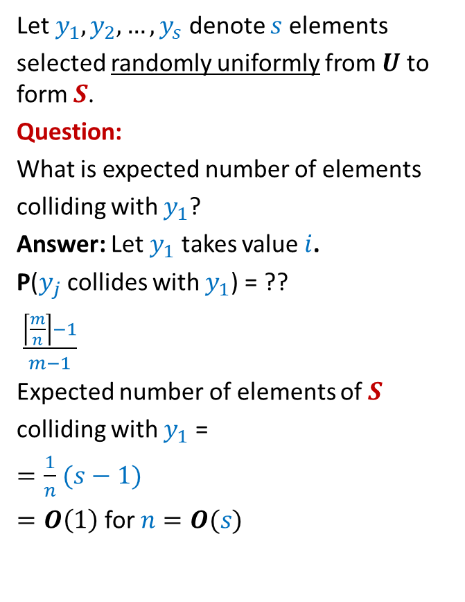


Why does hashing work so well in Practice ?
Let $y_{1},y_{2},…,y_{s}$ denote $s$elements
selected randomly uniformly from $U$ to form $S$.
Question:
What is expected number of elements
colliding with $y_{1}$?
Answer: Let $y_{1}$ takes value $i$.
P($y_{j}$ collides with $y_{1}$) = ??
$\frac{\left\lceil \frac{m}{n}\right\rceil −1}{m−1}$
Expected number of elements of $S$
colliding with $y_{1}$ =
$=\frac{1}{n}$ $(s−1)$
$=O\left(1\right)$ for $n=O(s)$
1
2
$$⋮$$
$$i−n$$
$$i$$
$≤\frac{1}{n}$
$$i+n$$
$$i+2n$$
$<\frac{s}{n}$
$$i+3n$$
$$⋮$$
m

Slide 10
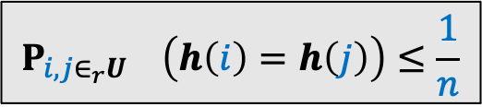


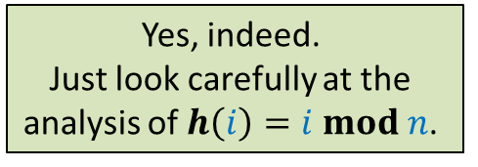
Why does hashing work so well in Practice ?
Conclusion
$h\left(i\right)=i mod n$ works so well because
for a uniformly random subset of $U$,
the expected number of collision at an index of $T$ is O(1).
Homework:
Show that for every hash function $h$ will also do well in practice provided it satisfies the following inequality.
Can there be other hash functions as well that will do well in practice ?
Yes, indeed.
Just look carefully at the
analysis of $h\left(i\right)=i mod n$.
$$P_{i,j∈_{r}U} \left(h\left(i\right)=h\left(j\right)\right)≤\frac{1}{n}$$
“How can we achieve worst case O(1) search time for a given set $S$.”
But it is easy to fool each such hash function
such that it achieves O(s) search time.

Slide 11
How to achieve worst case O(1) search time

Slide 12
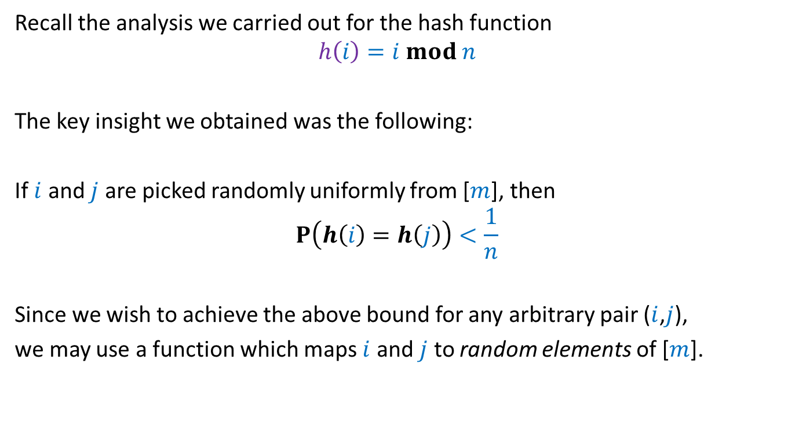
The intuition
Recall the analysis we carried out for the hash function
$$h\left(i\right)=i mod n$$
The key insight we obtained was the following:
If $i$ and $j$ are picked randomly uniformly from [$m$], then
$$P\left(h\left(i\right)=h\left(j\right)\right)<\frac{1}{n}$$
Since we wish to achieve the above bound for any arbitrary pair ($i$,$j$),
we may use a function which maps $i$ and $j$ to random elements of [$m$].

Slide 13

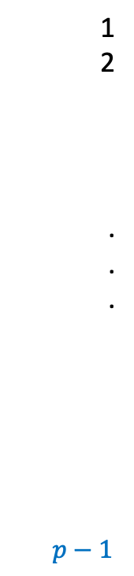
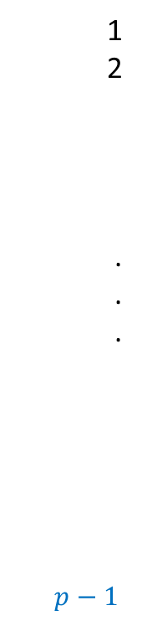

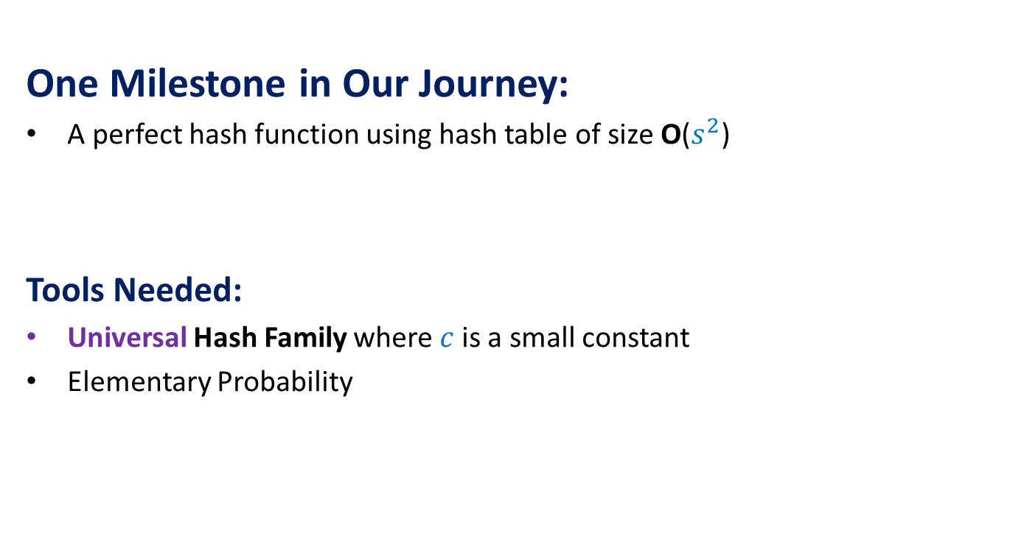
1
2
.
.
.
$p−1$
1
2
.
.
.
$p−1$
$$f$$
$$i$$
$$j$$

Slide 14

Revisiting mod operation
$p$ : a prime number
Assume $m=p−1$
$A$: {$1,2,…,p−1$}
$A^{∗}$: {$0,1,2,…,p−1$}

Slide 15









$$g_{x}\left(i\right)=ix mod p$$
1
2
.
.
.
$p−1$
1
2
.
.
.
$p−1$
$$g_{x}\left(i\right)=ix mod p$$
Fact:
If $x∈_{r}[1,…,p−1]$,
$g_{x}\left(i\right)$ is distributed randomly uniformly in$[1,…,p−1]$
Let $k$,$k^{′}∈$ $[1,…,p−1]$ and $k≠k′$
$$k′$$
$$g_{x}$$
$$i$$
$$j$$
$$k$$
P [$g_{x}\left(j\right)=k′ | g_{x}\left(i\right)=k$] = ?
$$∈\{0,1\}$$
$$x∈_{r}A$$

Slide 16

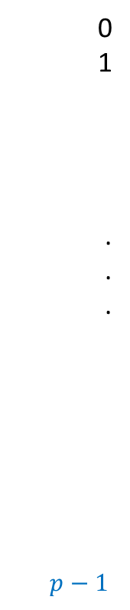





$q_{y}\left(i\right)=(i+y) mod$ $p$
1
2
.
.
.
$p−1$
0
1
.
.
.
$p−1$
$$q_{y}\left(i\right)=(i+y) mod p$$
Fact:
If $y∈_{r}[0,…,p−1]$,
$q_{y}\left(i\right)$ is distributed randomly uniformly in$[0,…,p−1]$
Let $k$,$k^{′}∈$ $[0,…,p−1]$ and $k≠k′$
$$k′$$
$$q_{y}$$
$$i$$
$$j$$
$$k$$
P [$q_{y}\left(j\right)=k′ | q_{y}\left(i\right)=k$] = ?
$$∈\{0,1\}$$
$$y∈_{r}A^{∗}$$

Slide 17





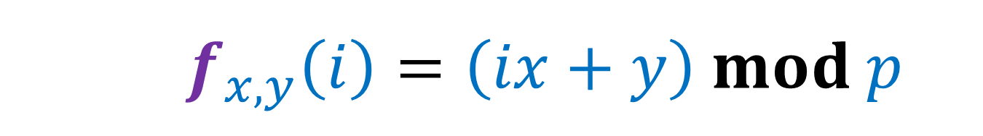




$$f_{x,y}\left(i\right)=\left(ix+y\right) mod p$$
1
2
.
.
.
$p−1$
0
1
.
.
.
$p−1$
$f_{x,y}\left(i\right)=(ix+y) mod p$
$=(ix mod p+y) mod p$
$=$ $q_{y}(g_{x}\left(i\right))$
$$k′$$
$$f_{x,y}$$
$g_{x}\left(i\right)=ix mod p$
$$i$$
$q_{y}\left(i\right)=(i+y) mod p$
$$j$$
$$k$$
P [$f_{x,y}\left(j\right)=k′ | f_{x,y}\left(i\right)=k$] = ?
$$x∈_{r}A$$
$$y∈_{r}A^{∗}$$

Slide 18







$$f_{x,y}\left(i\right)=\left(ix+y\right) mod p$$
1
2
.
.
.
$p−1$
1
2
.
.
.
$p−1$
0
1
.
.
.
$p−1$
$f_{x,y}\left(i\right)=(ix+y) mod p$
$=(ix mod p+y) mod p$
$=$ $q_{y}(g_{x}\left(i\right))$
$$x_{1}$$
$$y_{1}$$
$$g_{x}$$
$$q_{y}$$
$g_{x}\left(i\right)=ix mod p$
$$i$$
$q_{y}\left(i\right)=(i+y) mod p$
$$j$$
$$k$$

Slide 19


$$f_{x,y}\left(i\right)=\left(ix+y\right) mod p$$
1
2
.
.
.
$p−1$
1
2
.
.
.
$p−1$
0
1
.
.
.
$p−1$
$f_{x,y}\left(i\right)=(ix+y) mod p$
$=(ix mod p+y) mod p$
$=$ $q_{y}(g_{x}\left(i\right))$
$$x_{1}$$
$$y_{1}$$
$$g_{x}$$
$$q_{y}$$
$g_{x}\left(i\right)=ix mod p$
$$i$$
$q_{y}\left(i\right)=(i+y) mod p$
$$x_{2}$$
$$j$$
$$y_{2}$$
$$k$$

Slide 20







$$f_{x,y}\left(i\right)=\left(ix+y\right) mod p$$
$$j=\left(i+Δ\right) mod p$$
1
2
.
.
.
$p−1$
1
2
.
.
.
$p−1$
0
1
.
.
.
$p−1$
$f_{x,y}\left(i\right)=(ix+y) mod p$
$=(ix mod p+y) mod p$
$=$ $q_{y}(g_{x}\left(i\right))$
$f_{x_{ℓ},y_{ℓ}}\left(j\right)=$ ?
$$g_{x}$$
$$q_{y}$$
$g_{x}\left(i\right)=ix mod p$
$$i$$
$q_{y}\left(i\right)=(i+y) mod p$
$(k+Δ⋅x_{ℓ}) mod p$
$$j$$
$$k$$
Distributed uniformly over {$1,…,p−1$}
How is $j$ distributed?
There are {${(x}_{1},y_{1})$,…, ${(x}_{p−1},y_{p−1})$}
such that $f_{x_{ℓ},y_{ℓ}}\left(i\right)=k$

Slide 21



$$f_{x,y}\left(i\right)=\left(ix+y\right) mod p$$
$$j=\left(i+Δ\right) mod p$$
1
2
.
.
.
$p−1$
1
2
.
.
.
$p−1$
0
1
.
.
.
$p−1$
$f_{x,y}\left(i\right)=(ix+y) mod p$
$=(ix mod p+y) mod p$
$=$ $q_{y}(g_{x}\left(i\right))$
$f_{x_{ℓ},y_{ℓ}}\left(j\right)=$ ?
$$k′$$
$$g_{x}$$
$$q_{y}$$
$g_{x}\left(i\right)=ix mod p$
$$i$$
$q_{y}\left(i\right)=(i+y) mod p$
$(k+Δ⋅x_{ℓ}) mod p$
$$j$$
$$k$$
P [$f_{x,y}\left(j\right)=k′ | f_{x,y}\left(i\right)=k$] = ?
$$\frac{1}{p−1}$$
$$x∈_{r}A$$
$$y∈_{r}A^{∗}$$
There are {${(x}_{1},y_{1})$,…, ${(x}_{p−1},y_{p−1})$}
such that $f_{x_{ℓ},y_{ℓ}}\left(i\right)=k$

Slide 22

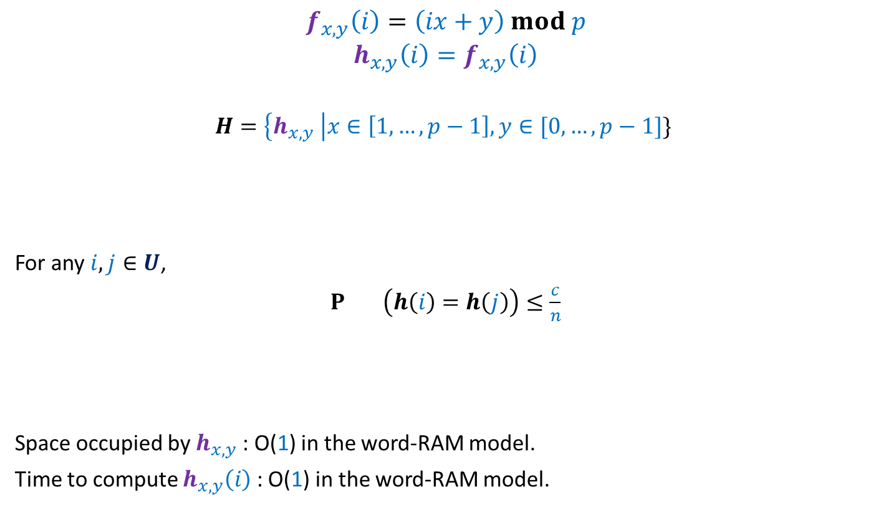

Inference
$$f_{x,y}\left(i\right)=\left(ix+y\right) mod p$$
$$h_{x,y}\left(i\right)=f_{x,y}\left(i\right)$$
$$H=\left\{h_{x,y} \right|x∈\left[1,…,p−1\right], y∈[0,…,p−1]\}$$
For any $i,j∈U$,
$P_{} \left(h\left(i\right)=h\left(j\right)\right)≤\frac{c}{n}$
Space occupied by $h_{x,y}$ : O(1) in the word-RAM model.
Time to compute $h_{x,y}\left(i\right)$ : O(1) in the word-RAM model.
$$mod n$$
$$h∈_{r}H$$

Slide 23


Universal Hash Family
Definition: A collection $H$of hash-functions is said to be c-universal
if there exists a constant $c$such that for any $i,j∈U$,
$P_{} \left(h\left(i\right)=h\left(j\right)\right)≤\frac{c}{n}$
$$h∈_{r}H$$

Slide 24
Why such a definition for Universal Hash family ?

Slide 25
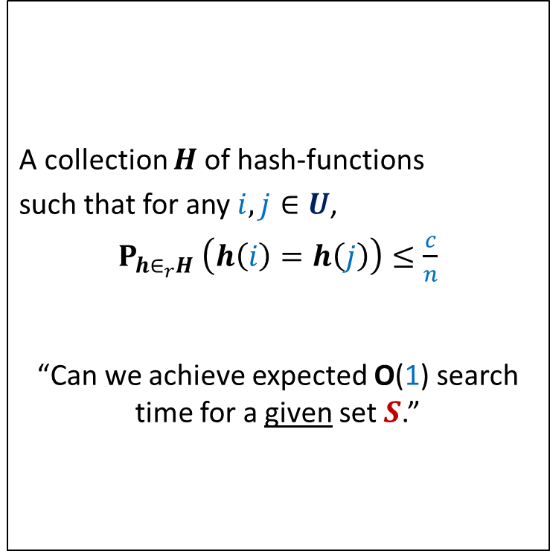
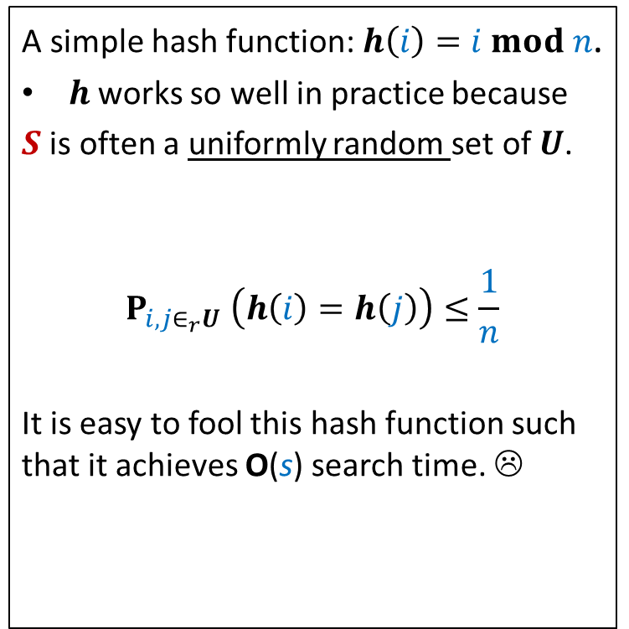
The INSPIRATION
Why does hashing work so well in Practice ?
A simple hash function: $h\left(i\right)=i mod n$.
$h$works so well in practice because
$S$ is often a uniformly random set of $U$.
$$P_{i,j∈_{r}U} \left(h\left(i\right)=h\left(j\right)\right)≤\frac{1}{n}$$
It is easy to fool this hash function such that it achieves O(s) search time. ☹
A collection $H$of hash-functions
such that for any $i,j∈U$,
$P_{h∈_{r}H} \left(h\left(i\right)=h\left(j\right)\right)≤\frac{c}{n}$
“Can we achieve expected O(1) search time for a given set $S$.”
Universal hash family
similar question while
Quick Sort ➔ Randomized Quick Sort

Slide 26
The Journey
One Milestone in Our Journey:
A perfect hash function using hash table of size O($s^{2}$)
Tools Needed:
Universal Hash Family where $c$is a small constant
Elementary Probability

Slide 27
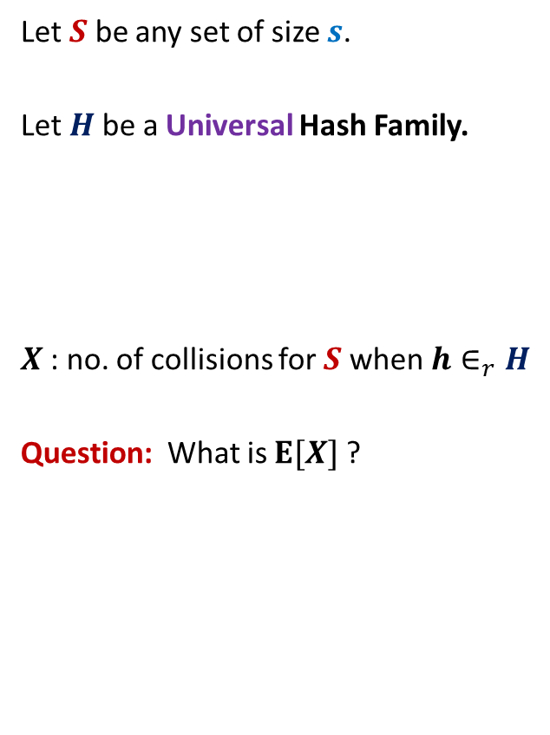

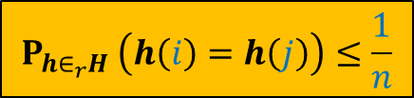
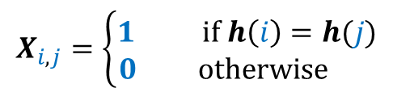
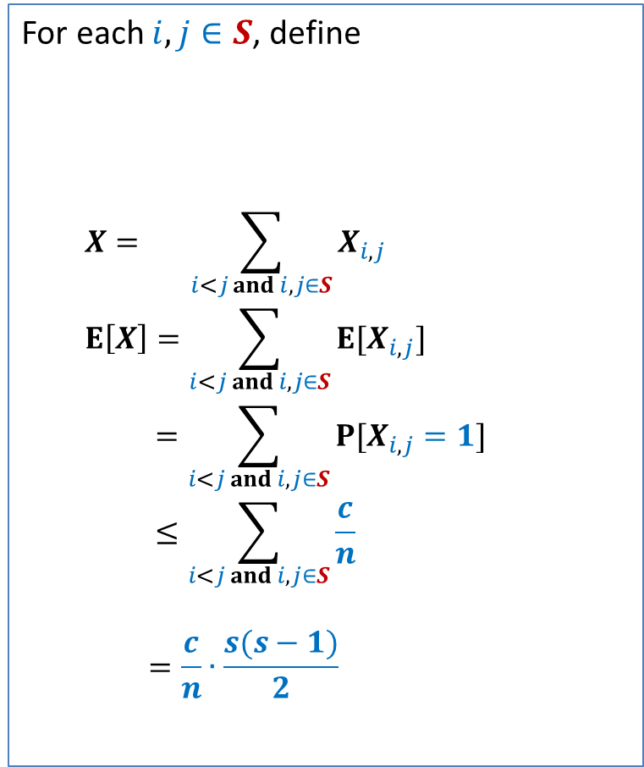
Perfect hashing using O($s^{2}$) space
Let $S$ be any set of size $s$.
Let $H$be a Universal Hash Family.
$X$: no. of collisions for $S$ when $h∈_{r}H$
Question: What is $E[X]$?
For each $i,j∈S$, define
$$X= \sum_{i<j and i,j∈S}{X_{i,j}}$$
$$E\left[X\right]=\sum_{i<j and i,j∈S}{E[X_{i,j}]}$$
$$=\sum_{i<j and i,j∈S}{P[X_{i,j}=1]}$$
$$≤\sum_{i<j and i,j∈S}{\frac{c}{n}}$$
$$=\frac{c}{n}∙\frac{s(s−1)}{2}$$
$$X_{i,j}=\left\{\begin{aligned}1 if h\left(i\right)=h(j) \\ 0 otherwise \end{aligned}\right.$$
$$P_{h∈_{r}H} \left(h\left(i\right)=h\left(j\right)\right)≤\frac{1}{n}$$

Slide 28
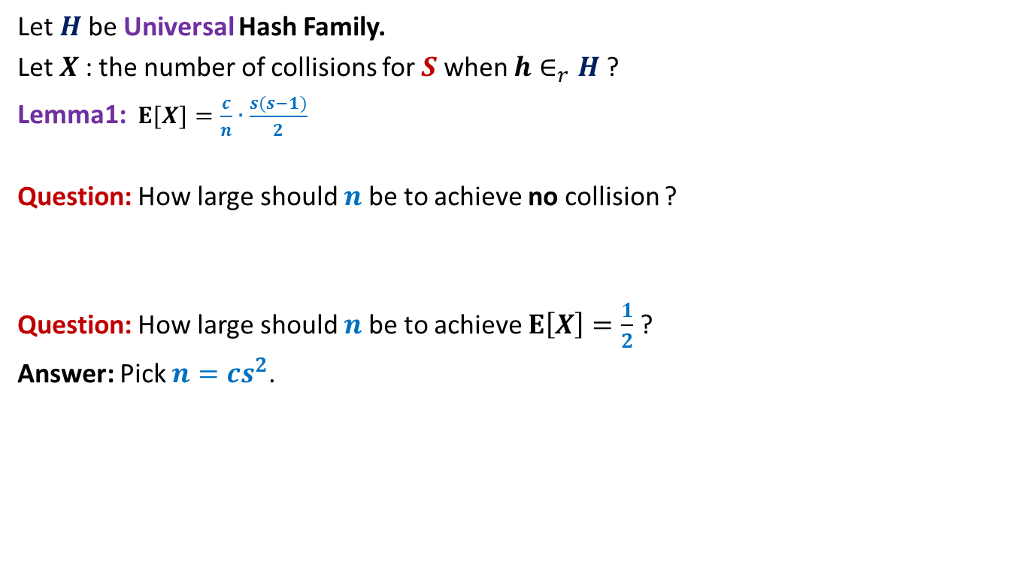
Perfect hashing using O($s^{2}$) space
Let $H$be Universal Hash Family.
Let $X$: the number of collisions for $S$ when $h∈_{r}H$?
Lemma1:$E[X]=\frac{c}{n}∙\frac{s(s−1)}{2}$
Question: How large should $n$be to achieve no collision ?
Question: How large should $n$be to achieve $E\left[X\right]=\frac{1}{2}$ ?
Answer: Pick $n=cs^{2}$.

Slide 29
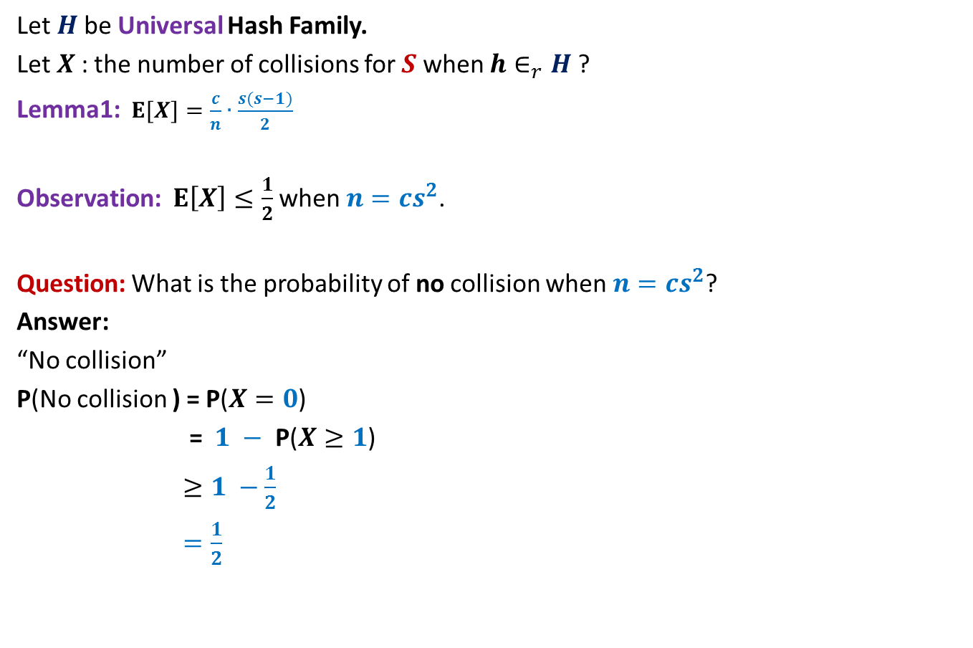

Perfect hashing using O($s^{2}$) space
Let $H$be Universal Hash Family.
Let $X$: the number of collisions for $S$ when $h∈_{r}H$?
Lemma1:$E[X]=\frac{c}{n}∙\frac{s(s−1)}{2}$
Observation: $E\left[X\right]≤\frac{1}{2}$ when $n=cs^{2}$.
Question: What is the probability of no collision when $n=cs^{2}$?
Answer:
“No collision”
P(No collision ) = P($X=0$)
= $1 −$ P($X≥1$)
$≥1 −\frac{1}{2}$
$=\frac{1}{2}$
⬄ “$X=0$”
Use Markov’s Inequality to bound it.

Slide 30
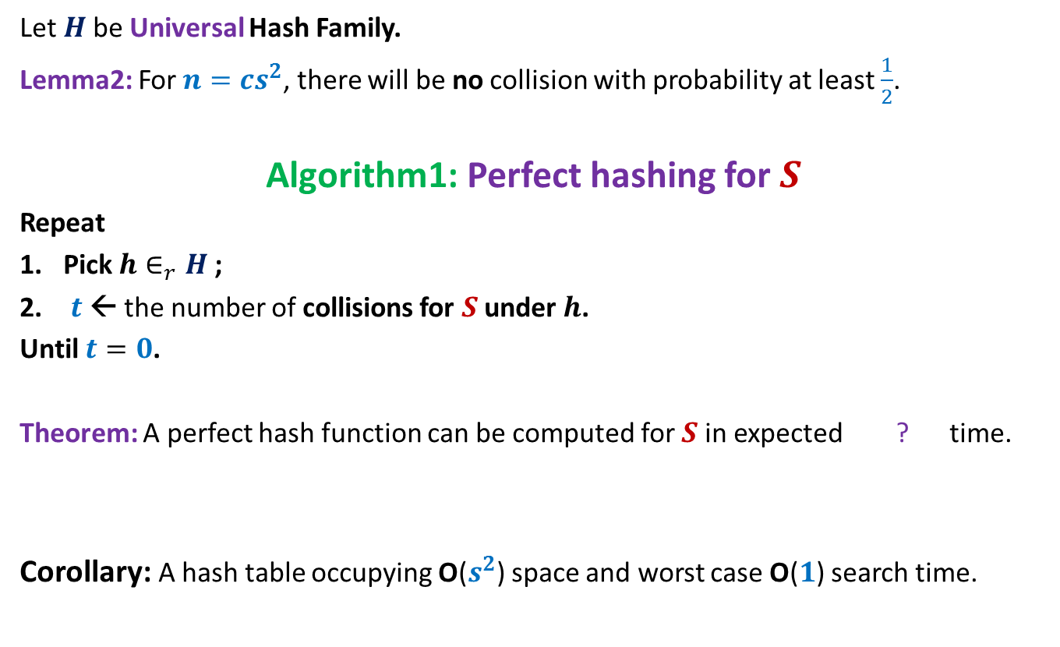

Perfect hashing using O($s^{2}$) space
Let $H$be Universal Hash Family.
Lemma2: For $n=cs^{2}$, there will be no collision with probability at least $\frac{1}{2}$.
Algorithm1: Perfect hashing for $S$
Repeat
Pick $h∈_{r}H$;
$t$← the number of collisions for $S$ under $h$.
Until $t=0$.
Theorem: A perfect hash function can be computed for $S$in expected ? time.
Corollary: A hash table occupying O($s^{2}$) space and worst case O($1$) search time.
O($s^{2}$)

Slide 31
Homework
Make sincere attempts to achieve O(1) worst case time using O(s) space only.

